Slide 1
Lecture 2

Slide 2
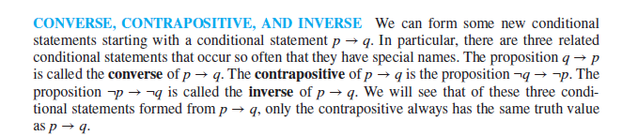
Converse, Contrapositive and Inverse

Slide 3

Converse, Contrapositive and Inverse

Slide 4
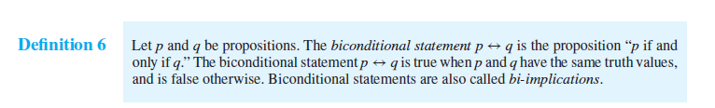
Bi-conditional

Slide 5
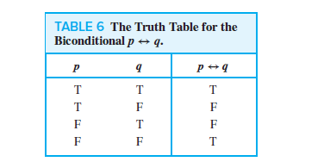
Bi-conditional

Slide 6
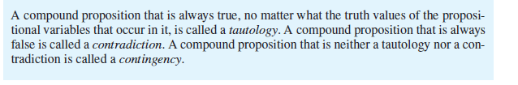
Tautology and contradiction

Slide 7
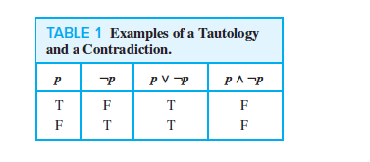
Tautology and contradiction

Slide 8
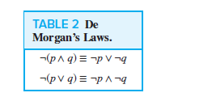
Demorgan’s law

Slide 9

Demorgan’s law

Slide 10
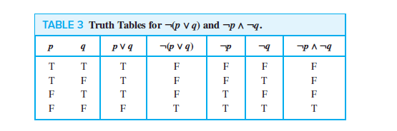
Demorgan’s law

Slide 12
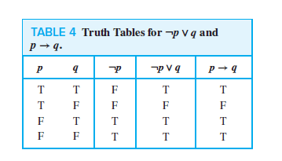

Slide 14
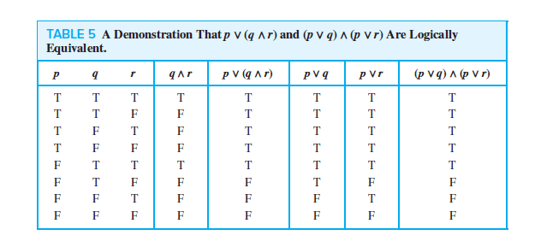

Slide 15


Slide 17


Slide 18

Predicate

